Slide 1
Availability Problems in the DNSSEC Deployment
Eric Osterweil
Dan Massey
Lixia Zhang

Slide 2
Motivation: Why Use DNSSEC?
DNS cache poisoning has been a known attack against DNS since the 1990s [1]
  Now there is a new variant: the Kaminsky attack
Patches to existing resolvers and name servers have helped mitigate recent threats
However, DNSSEC offers a more structured solution to ensure data’s origin authenticity and integrity
  European operational efforts have (arguably) lead the way on the deployment front

Slide 3
Has DNSSEC Overstressed the DNS?
DNSSEC added a lot to DNS packets
We added crypto keys (DNSKEYs)
  Anywhere up to 4,096 bits each
  Zones should have at least 2 (ZSK + KSK) and maybe more
We added crypto signatures (RRSIGs )
  At least one in each RRset and sometimes one for each DNSKEY
  Varying in size, based on DNSKEY sizes
Resolvers and name servers need to send and receive these large DNS packets
In this talk we examine a prominent availability problem in DNSSEC’s deployment

Slide 4
Outline
DNSSEC background
The network path and large packets
How SecSpider measures
Observations
What can be done

Slide 5
DNSSEC Background
DNSSEC provides origin authenticity, data integrity, and secure denial of existence by using public-key cryptography
Origin authenticity:
  Resolvers can verify that data has originated from authoritative sources.
Data integrity
  Can also verify that responses are not modified in-flight
Secure denial of existence
  When there is no data for a query, authoritative servers can provide a response that proves no data exists

Slide 6
How DNSSEC Works
DNSSEC zones create public/private keys
  Public portion goes in DNSSEC record type: DNSKEY
Zones sign all RRsets and resolvers use DNSKEYs to verify them
  Each RRset has a signature attached to it: RRSIG
So, once a resolver has a zone’s DNSKEY(s) it can verify that RRsets are intact by verifying their RRSIGs

Slide 7
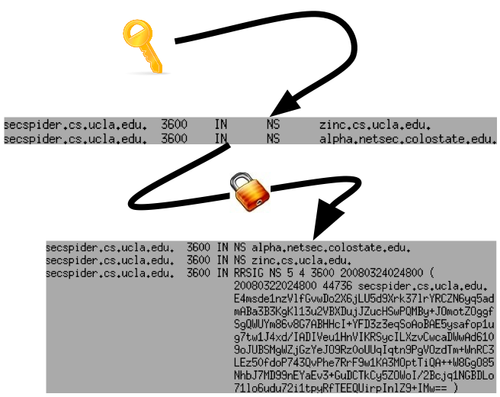
Signing Example
Using a zone’s key
on a standard RRset
(the NS)
Signature (RRSIG) will
only verify with the
DNSKEY if no
data was
modified

Slide 8
Large Message Support in DNSSEC
Originally, DNS messages were limited to 512 bytes
  Resolvers use EDNS0 “negotiation” (RFC 2671) to advertise how much DNS buffer space they have for DNS messages
Name servers try to fit data into buffers of that size
  If data won’t fit, servers indicate response is “truncated”
  Resolvers should explore alternate message size,
  “…considered preferrable to the outright use of TCP…”
Without exploration, both sides hope the path between them will tolerate UDP packets of that size
  This can result in false advertising
We will show that this has lead to problems

Slide 9
Outline
DNSSEC background
The network path and large packets
How SecSpider measures
Observations
What can be done

Slide 10
The Network Path and PMTU
A network path is a sequence of links
Each link can only support packets of a certain size (MTU)
The smallest MTU for a network path is its bottleneck, or its Path Maximum Transmission Unit (PMTU)

Slide 11
Further Complications with DNS’ Large Packets
DNS messages are further limited by “middle boxes” (firewalls, NAT, etc.)
  Some firewalls drop “suspicious” DNS traffic
  A recent study found this was quite common in SOHO routers [2]
Because of middle boxes, network paths that may support large packets may fail to deliver large DNS messages
We overload the term PMTU to apply in these cases too

Slide 12
How One Can Identify PMTU Problems
Suppose a resolver advertizes a buffer size to a name server, but that size exceeds the PMTU
  Result: message is dropped along the network path
Distinguishing random drops from PMTU failures
  Retry queries 3 times
Distinguishing name server failures from PMTU failures
  Reissue queries with different EDNS0 buffer sizes
  Query from different network vantages
  Verify the problem exists over time
  Check if TCP works

Slide 13
Outline
DNSSEC background
The network path and large packets
How SecSpider measures
Observations
What can be done

Slide 14
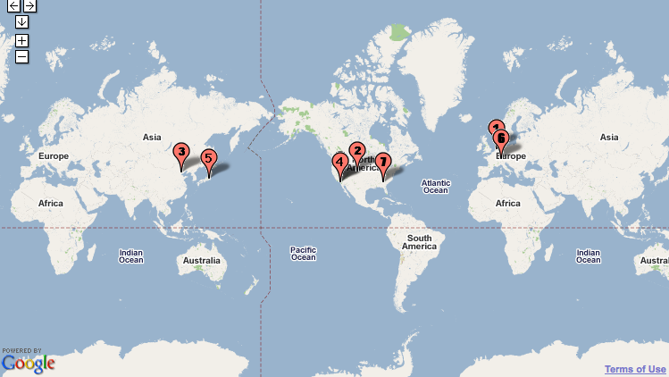
SecSpider’s Vantage Points
We poll all of our
DNSSEC zones from 8
vantages in:
  Europe
  Asia
  North America
We’re always looking for more
  Please consider hosting a lightweight poller for us
  Please drop me a note if you might be interested eoster@cs.ucla.edu

Slide 15
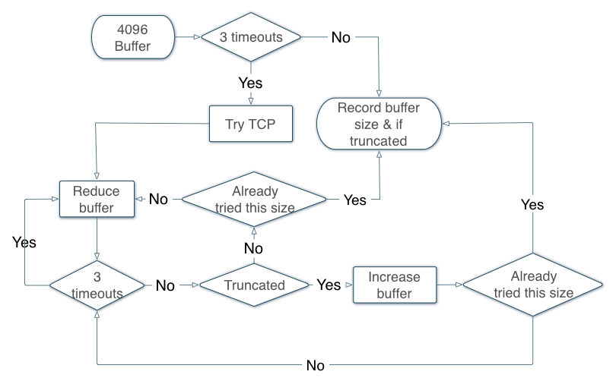
SecSpider’s PMTU Walking
To trigger a PMTU
walk there must be
3 successive DNSKEY
query timeouts
After 3 timeouts, we
try TCP
Then we perform a
binary search between
4,096 and 512 to see if any size will work
  Find out precisely what size works before a failure or truncation

Slide 16
Outline
DNSSEC background
The network path and large packets
How SecSpider measures
Observations
What can be done

Slide 17
What We Have Observed
A recent study [4] showed that roughly 60% of queries seen at one root server advertise buffer sizes of 4,096
In this talk we use our distributed pollers to illustrate:
  How often does the default behavior of using 4,096 byte buffers work for DNSSEC
  When it fails, is it possible to advertise smaller buffer sizes that will work
  How often are key sets just too large to fit over paths
To illustrate, consider how different 2 pollers results’ can be
  For example, NL NetLabs and a SOHO router (cable modem)

Slide 18
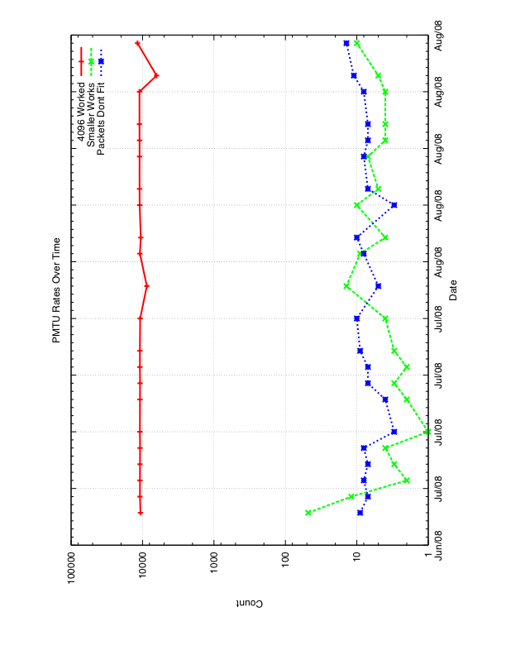
NL NetLabs Poller

Slide 19
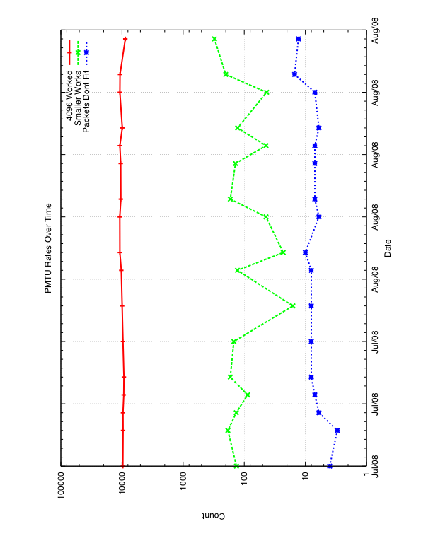
SOHO Router in Los Angeles

Slide 20
It Matters Where You Look From
NL NetLabs only has trouble with roughly 10 zones (for the most part)
However, at the same time, our SOHO router has PMTU problems with roughly 100 zones

Slide 21
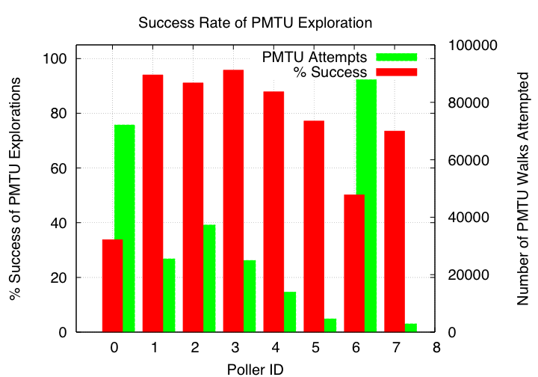
As Seen From All of Our Pollers
Green bars indicate the number of times a poller needed to do a PMTU walk
Red bars indicate the percentage of times a PMTU was was able to find a buffer size the allowed DNSKEYs to be received

Slide 22
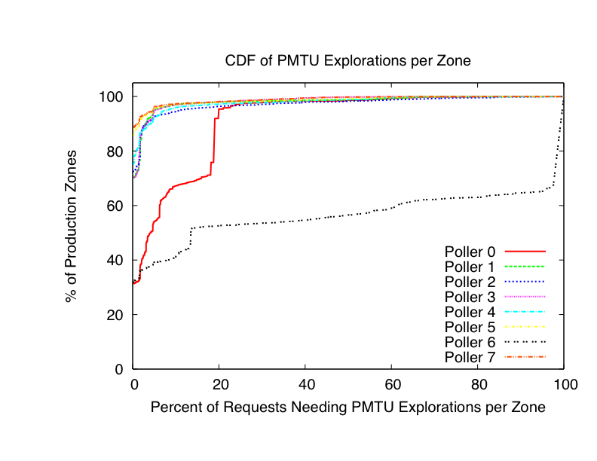
How Many Zones Have Trouble?
Fraction of queries (x-axis) that cause PMTU exploration (y-axis)
For Ex: from poller 0: ~70% of the production zones only need PMTU walks ~20% of the time (or less)
Poller 6: ~60% of the zones need PMTU walks up to 90% of the time

Slide 23
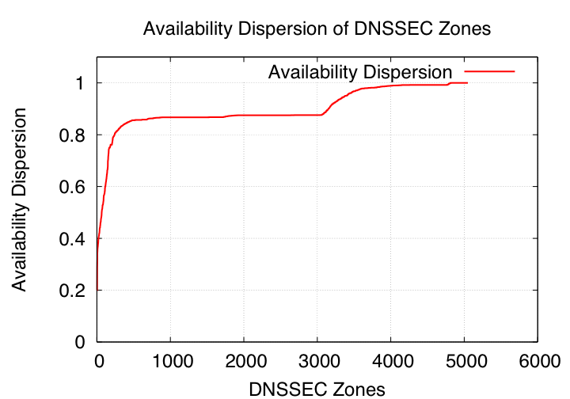
More Succinct
We use a metric from [3] to quantify the “availability dispersion” of each zone
  Captures how different each poller’s view of each zone is
Using a weighted average over time, we see that most zones have suffered dispersion

Slide 24
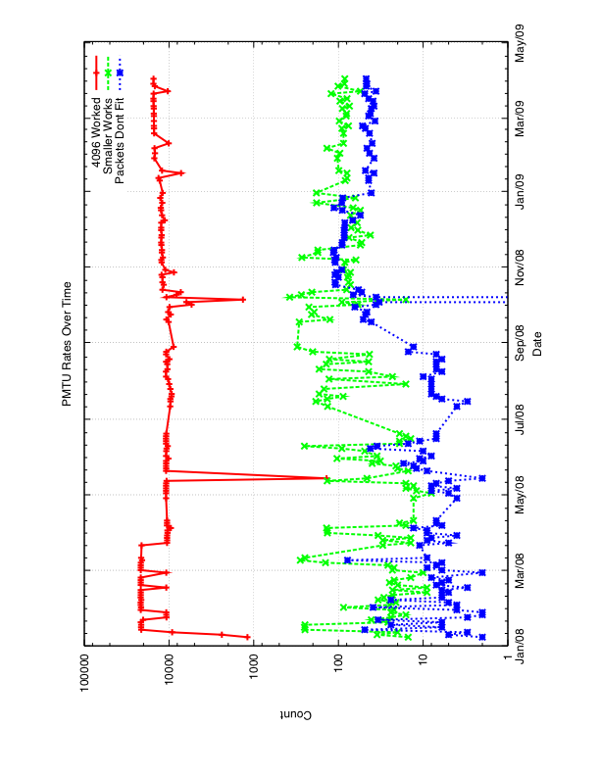
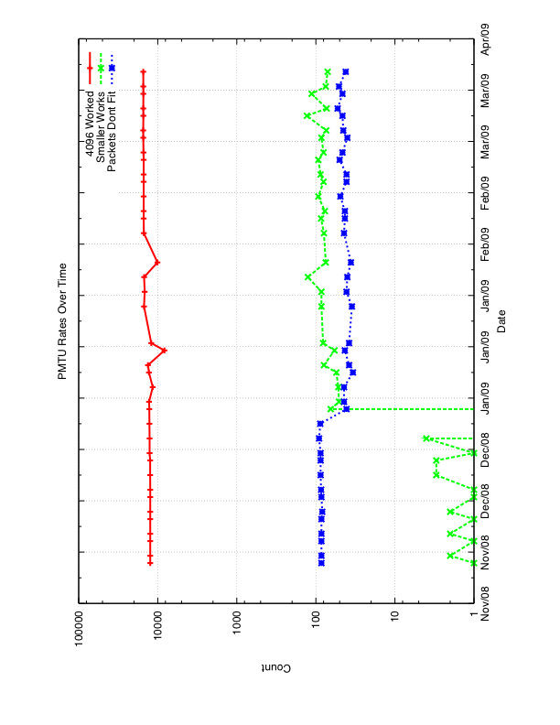
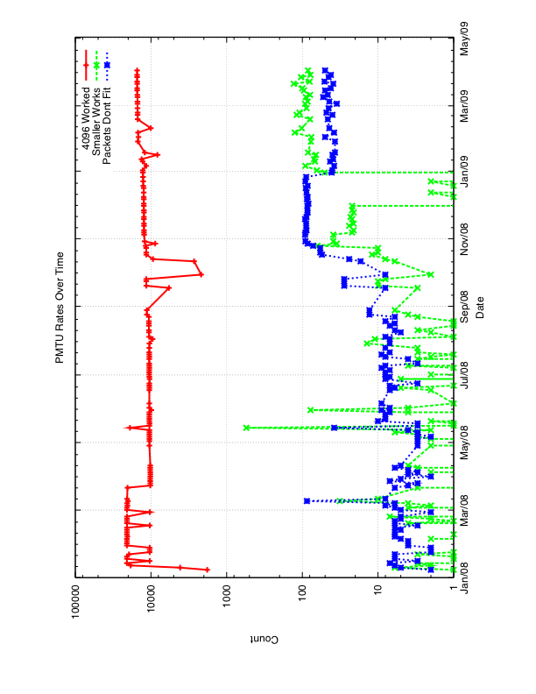
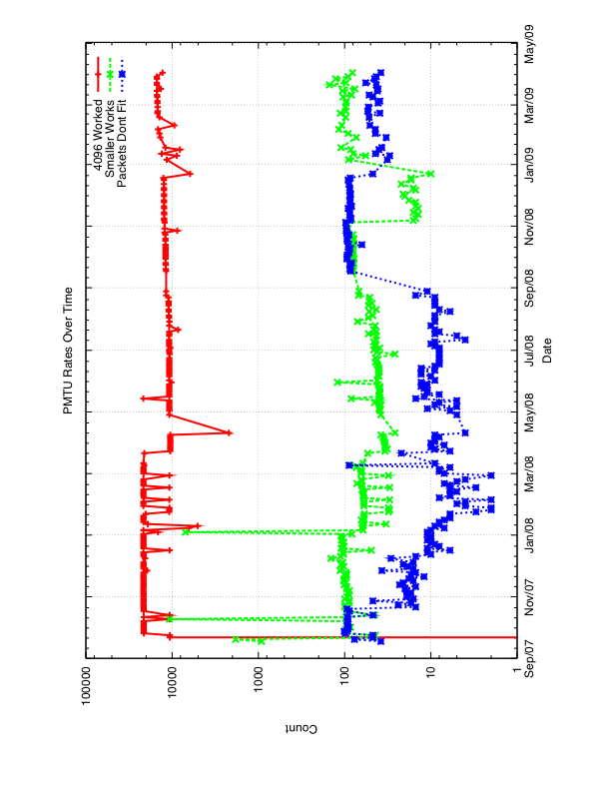
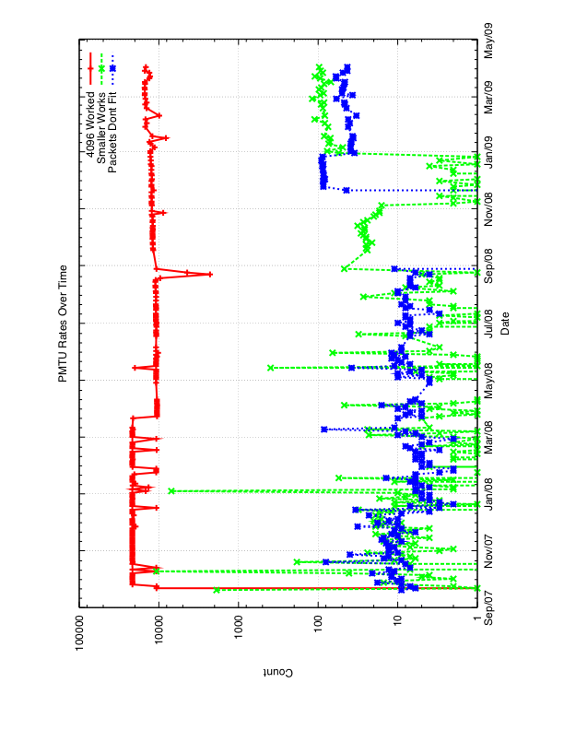
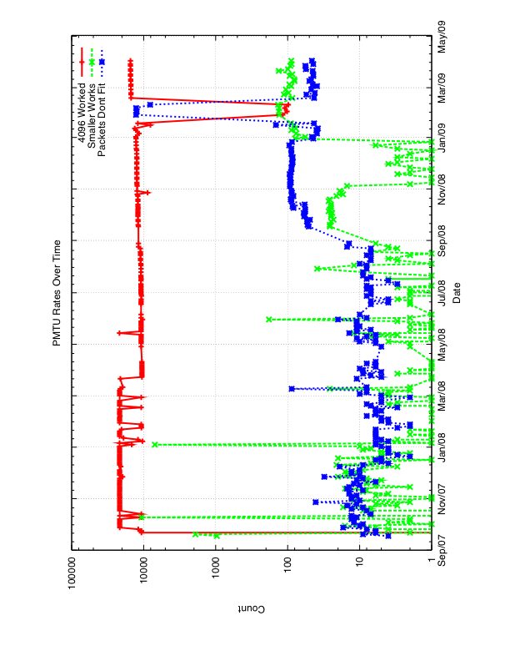
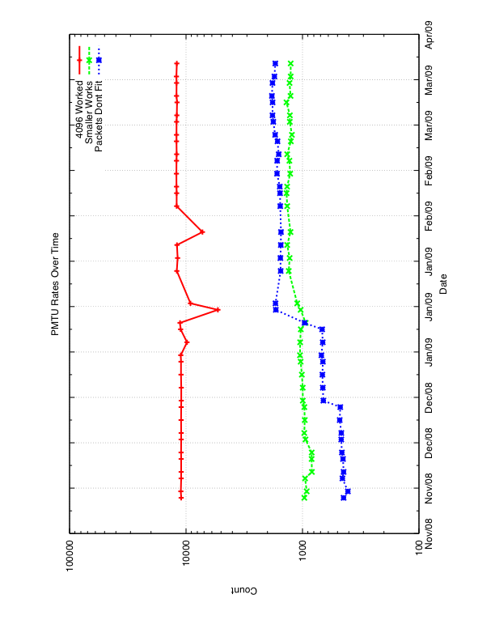
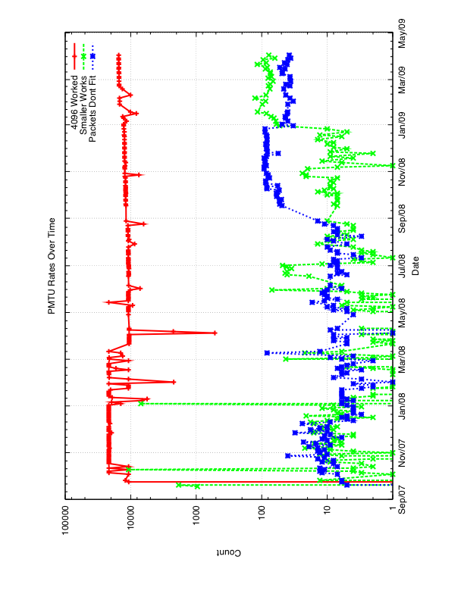
Something Interesting…

Slide 25
A Correlated Jump in Walks
In September of 2008, roughly 100 zones began serving DNSKEYs that didn’t “fit” their PMTUs
In November, availability seems restored, but only with PMTU walks
Still investigating causes, but zones can check their status at
  http://secspider.cs.ucla.edu/

Slide 26
Outline
DNSSEC background
The network path and large packets
How SecSpider measures
Observations
What can be done

Slide 27
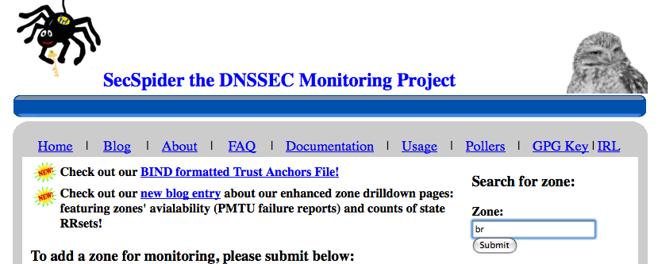
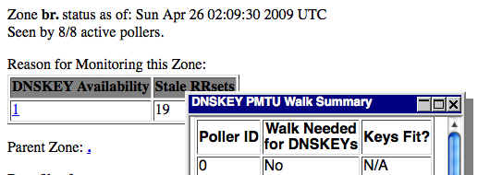
What Can be Done (Tactically)
Check your zones’ availability at: http://secspider.cs.ucla.edu/
  We are more than happy to work with anyone that has questions

Slide 28
What Can be Done (Strategically)
Try different DNSKEY configurations then monitor and observe availability through SecSpider
Use results to collaborate on best-practices documents
Continue to raise awareness of the problem
Develop availability dispersion and PMTU recommendations

Slide 29
Summary
We use Availability dispersion to allow us to expresses how different all of the resolvers’ views are
Distributed monitoring needs to be a service that lets zone operators to assess their zones’ availability dispersion
SecSpider been helping to reveal problems (such as a spike in PMTU walks) before they become insurmountable challenges to the deployment

Slide 30
References
Bellovin, S. M. 1995. Using the domain name system for system break-ins. USENIX UNIX Security Symposium 1995
http://download.nominet.org.uk/dnssec-cpe/DNSSEC-CPE-Report.pdf
Osterweil, E., Ryan, M., Massey, D., and Zhang, L. 2008. Quantifying the operational status of the DNSSEC deployment. ACM SIGCOMM Conference on Internet Measurement. IMC '08
https://www.dns-oarc.net/node/146

Slide 31
Thank You
Questions?

